Slide 1

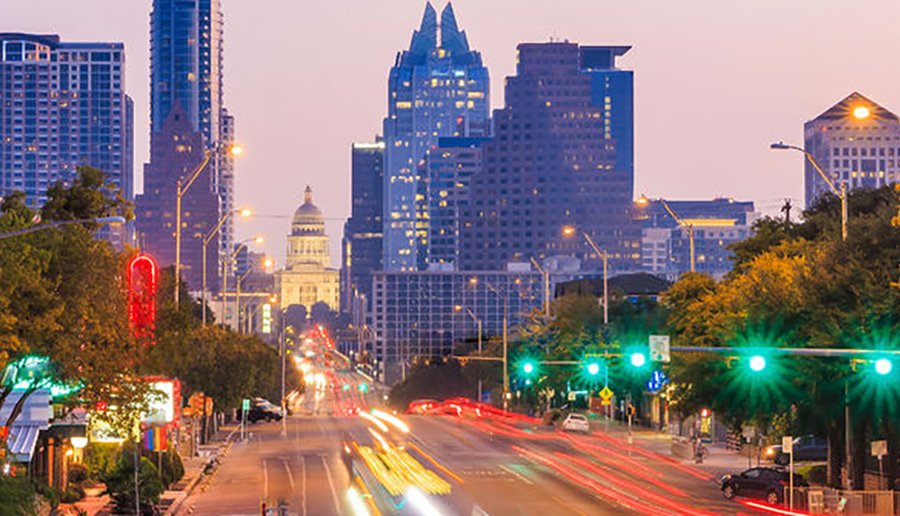
Austin Rough Roads Ahead:
Analyzing Austin's Road Conditions
Luz Solorzano-Ortiz, Joe Ortiz, Chloe Roque

Slide 2
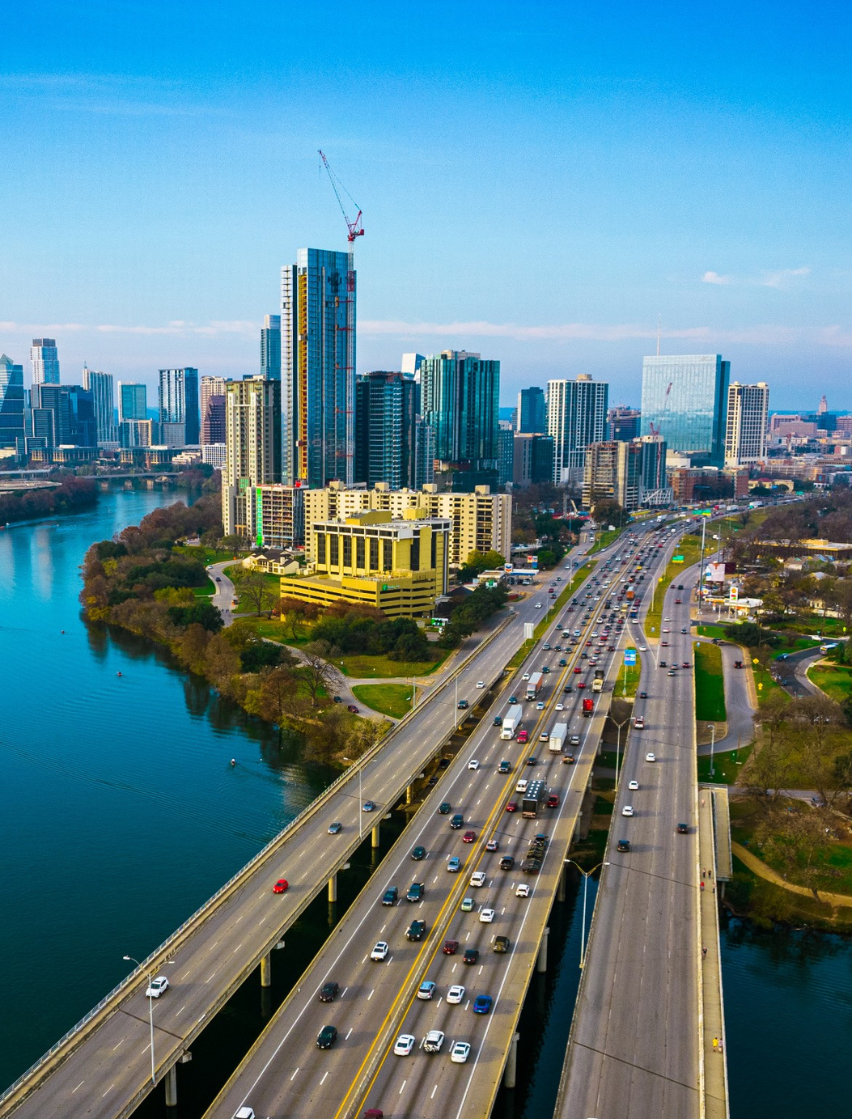
Unpacking our Data
Entries updated live on data.austintexas.gov
4.8 million rows and 24 columns
4.1 million rows after filtering
Time frame: 2021 - 2024*
Temperature is in celcius

Slide 3
Objectives
Compare locations and decide why their road conditions are better than the other
Explore different variables and their effects on road condition
Location analysis

Slide 4
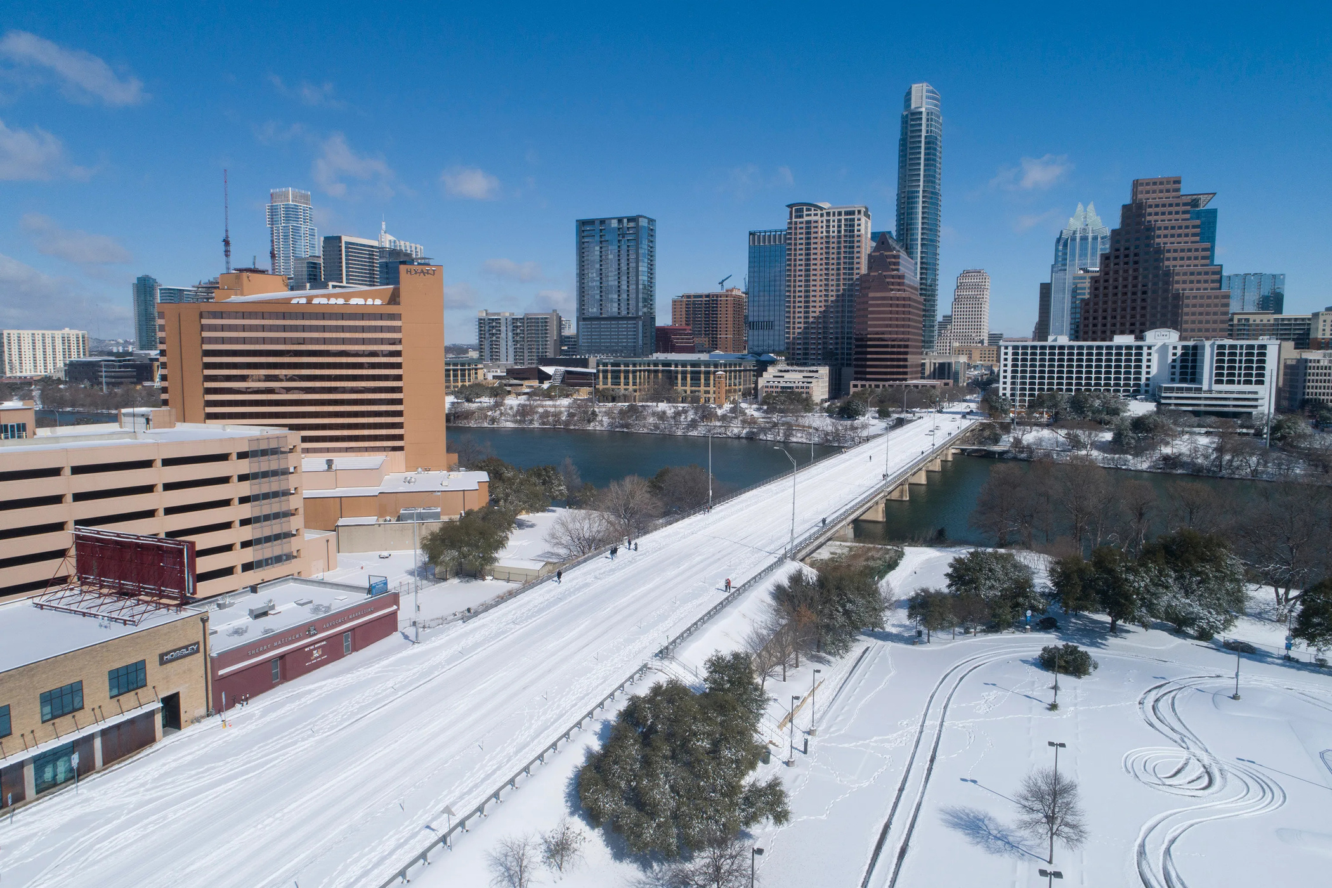
The Effect of Temperature on Austin Roads

Slide 5
There isn’t necessarily a strong one!
Based on the correlation value, temperature surprisingly is not a factor that strongly affects road conditions.

Slide 6
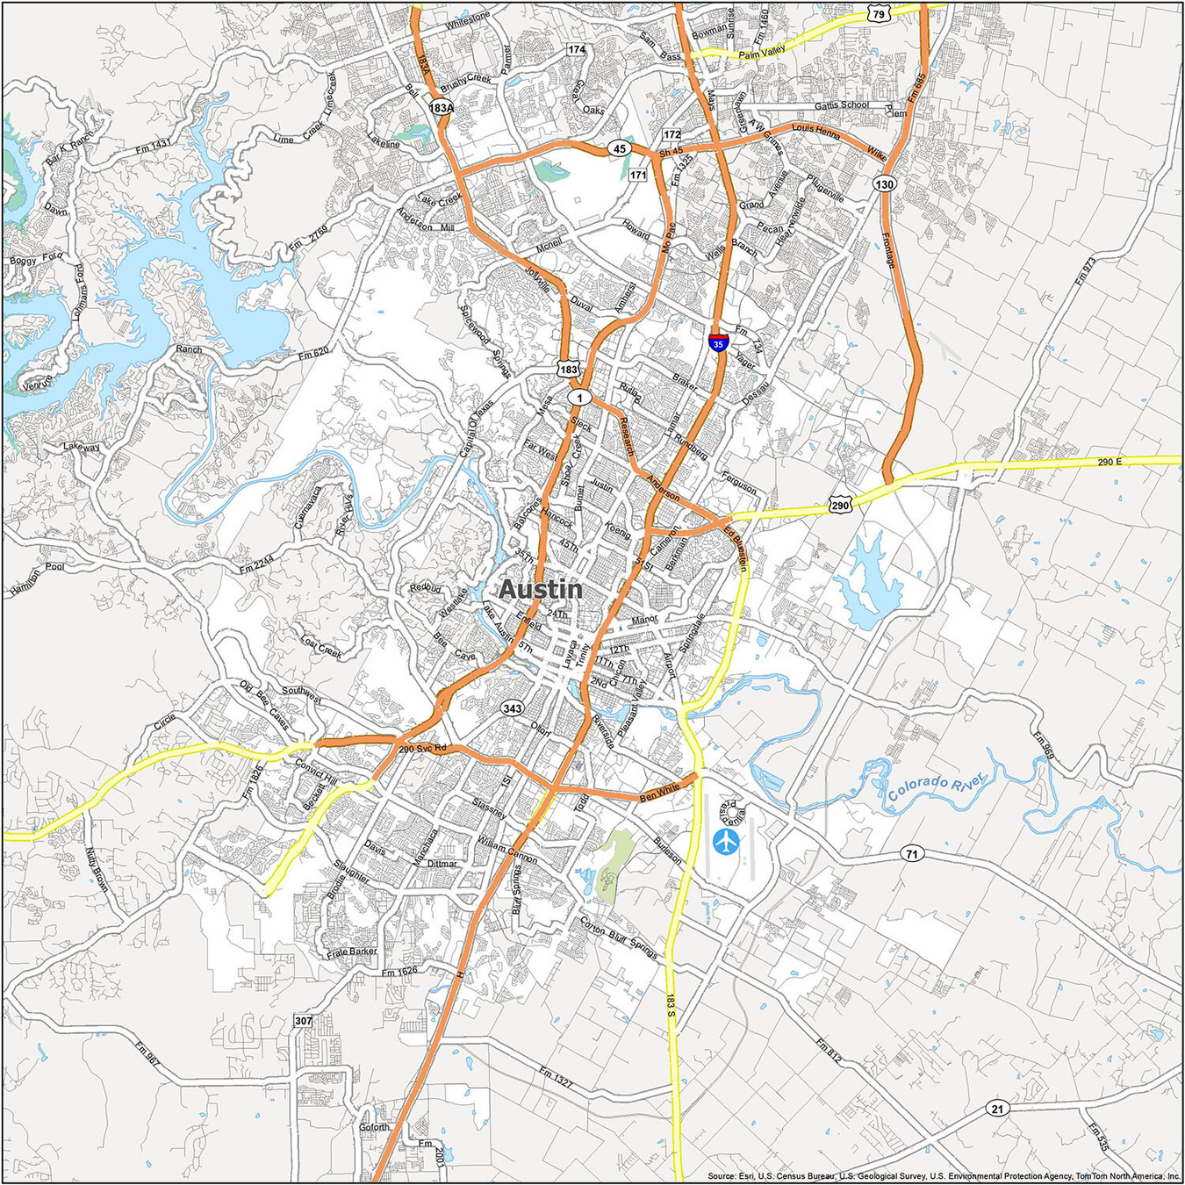
Location Analysis

Slide 7
Location Analysis
Ben White BLVD SVRD / Banister LN

Slide 8
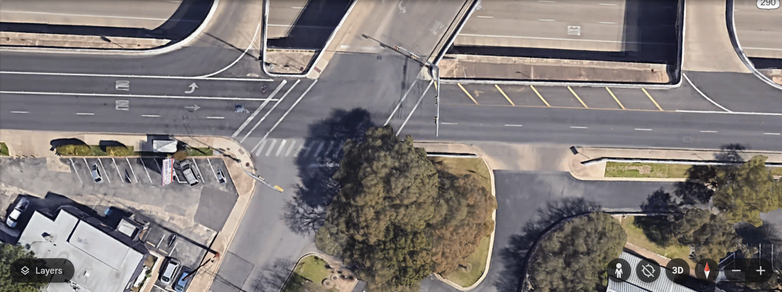

BEN WHITE BLVD SVRD / BANISTER LN
(South Austin)

Slide 9
Location Analysis
11th ST / 35 SVRD
Ben White BLVD SVRD / Banister LN

Slide 10
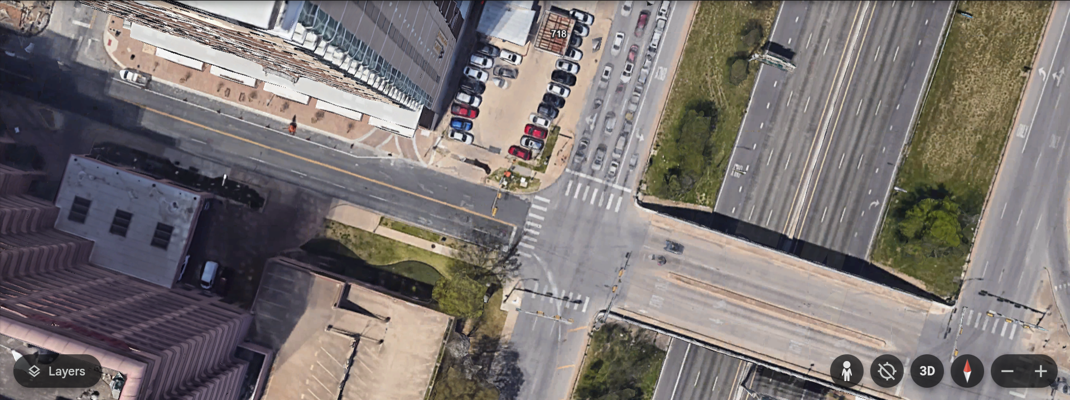
11TH ST / 35 SVRD
(Downtown Austin)

Slide 11
FM 2222 RD / Lakewood DR
Location Analysis
11th ST / 35 SVRD
Ben White BLVD SVRD / Banister LN

Slide 12
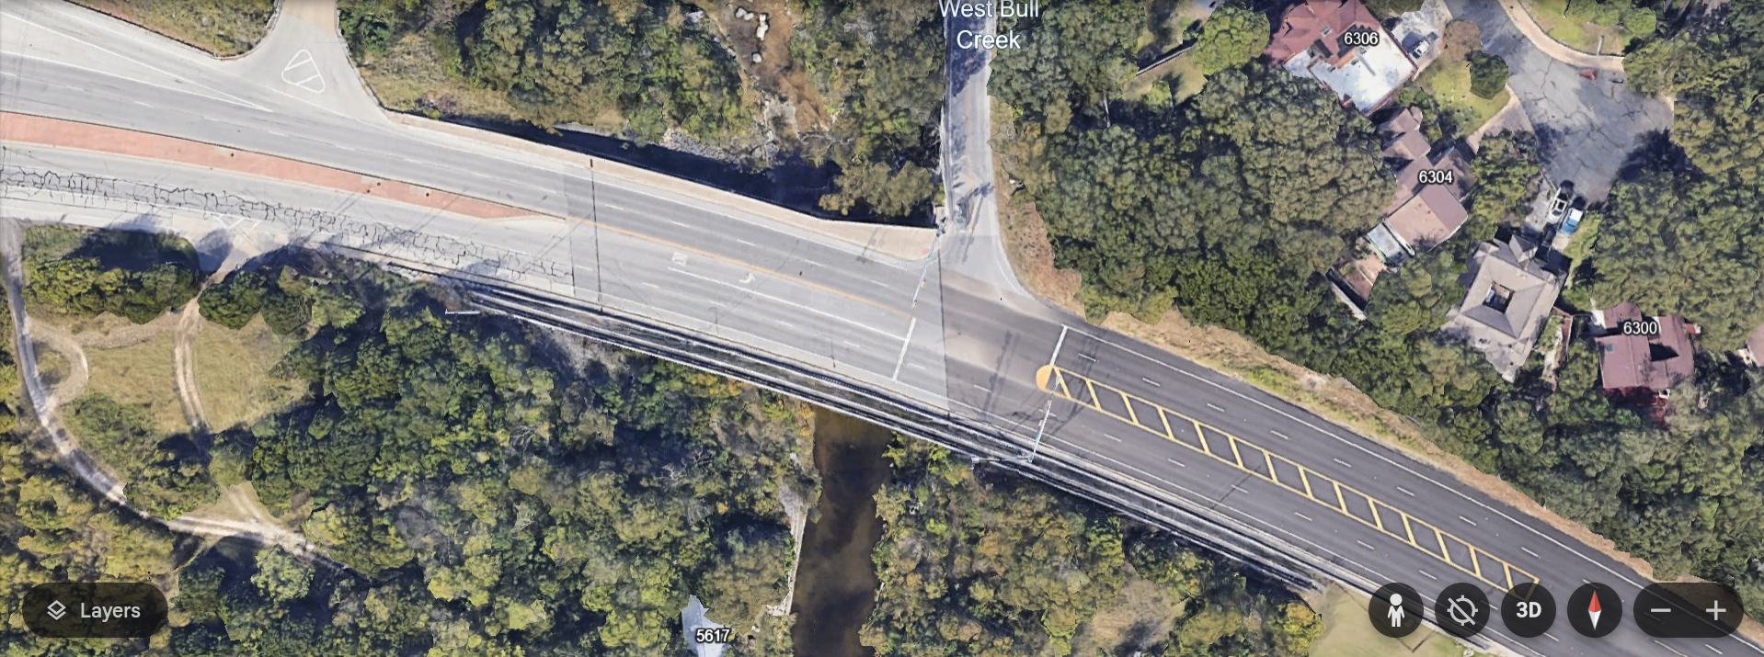
FM 2222 RD / Lakewood DR
(North West Austin)
FM 2222 is the bridge that we do an analysis about later. Will need ot figure out how to make it flow.

Slide 13
Lakeline BLVD / 183 HWY SVRD
FM 2222 RD / Lakewood DR
Location Analysis
11th ST / 35 SVRD
Ben White BLVD SVRD / Banister LN

Slide 14
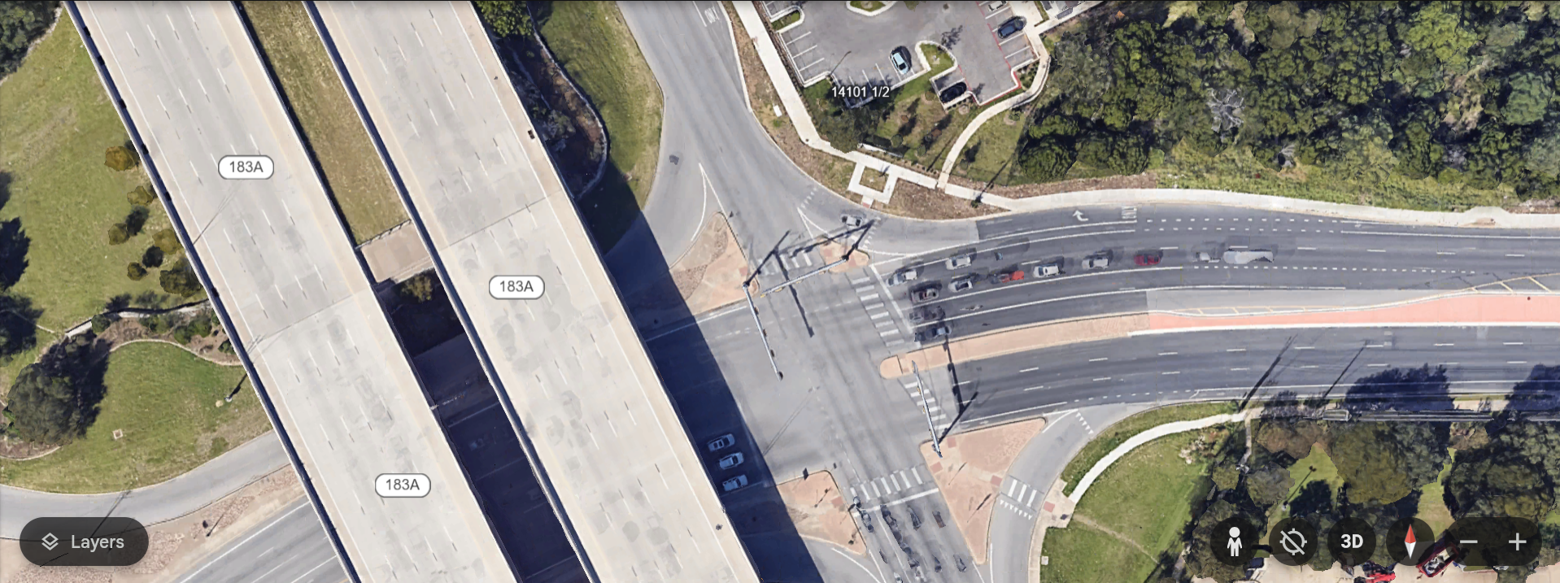
LAKELINE BLVD / 183 HWY SVRD
(North Austin)

Slide 15
NORTH AUSTIN
NORTH WEST AUSTIN
Location Analysis
DOWNTOWN
SOUTH AUSTIN

Slide 16
NORTH AUSTIN
NORTH WEST AUSTIN
Location Analysis
DOWNTOWN
SOUTH AUSTIN

Slide 17
NORTH AUSTIN
NORTH WEST AUSTIN
Location Analysis
DOWNTOWN
SOUTH AUSTIN
*11TH / 35 sensor has a “dirty lense” calibration code, so the data from that location sadly is not useful

Slide 18
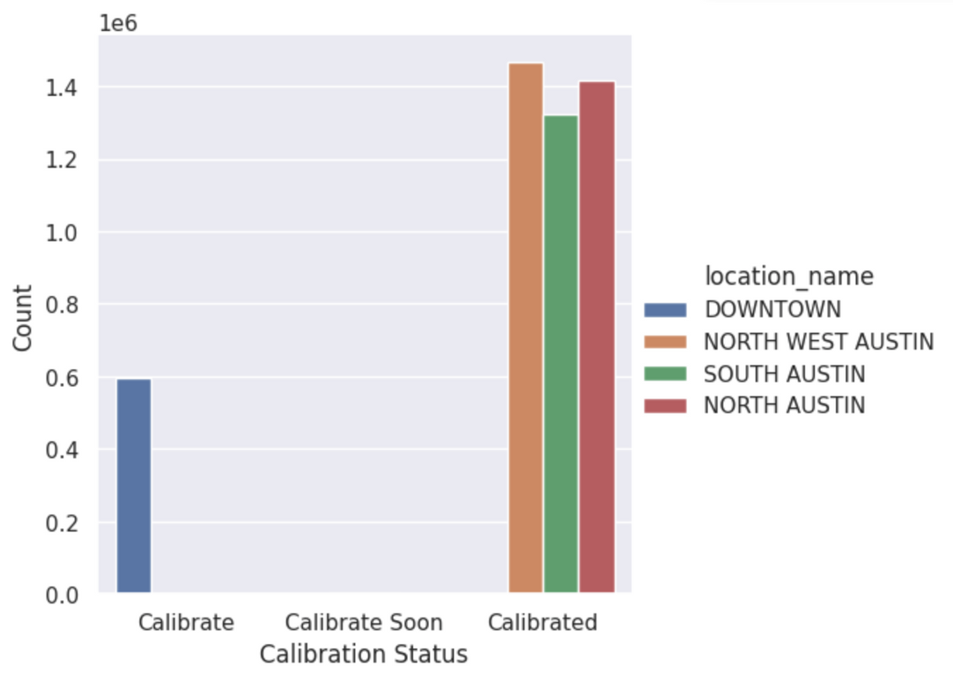
Bad Sensor at Downtown

Slide 19
Bad Sensor at Downtown

Slide 20
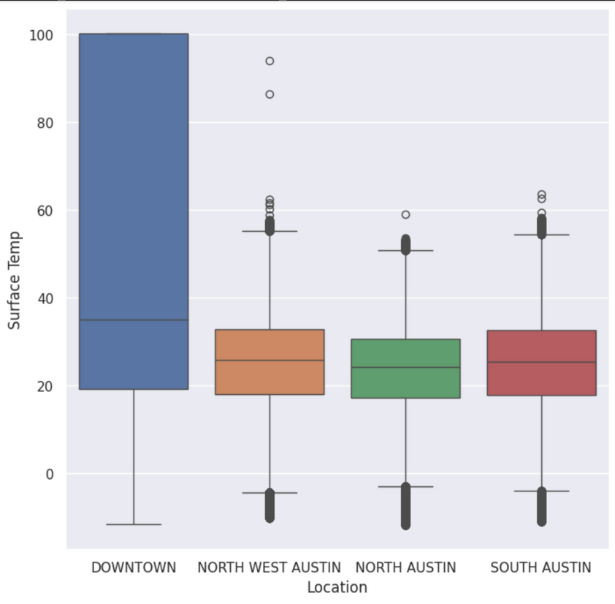
Bad Sensor at Downtown

Slide 21
Bad Sensor at Downtown

Slide 22
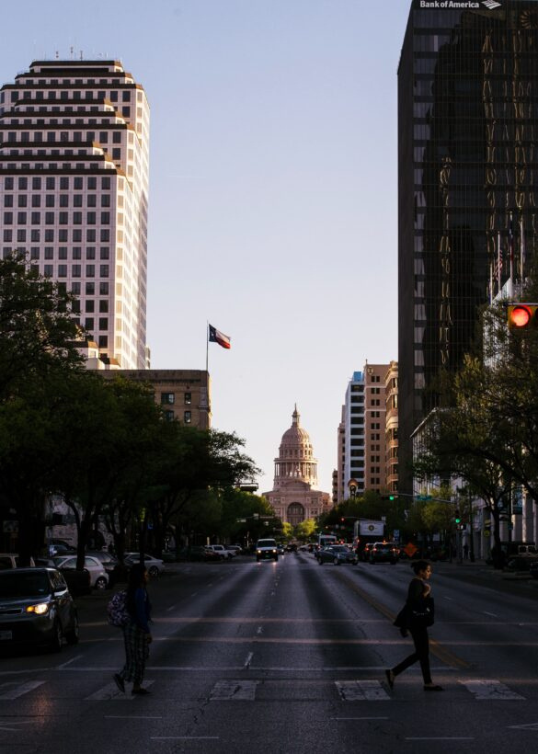
Comparing Location and Road Conditions

Slide 23
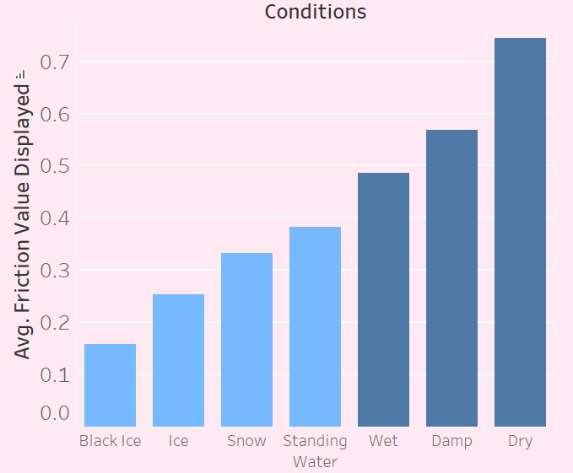
Condition Effect on Friction
Lowest average friction is found with these 4 “bad” road conditions.

Slide 24
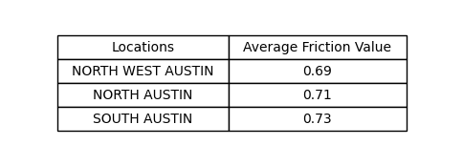
Friction by Location

Slide 25
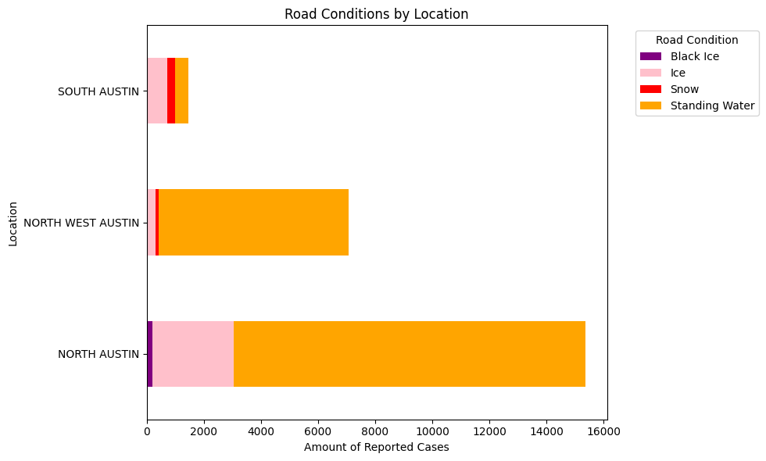
Bad Road Conditions by Location

Slide 26
Bad Road Conditions by Location

Slide 27
Bad Road Conditions by Location
South Austin has the best road conditions

Slide 28
Geographical Factors

Slide 29
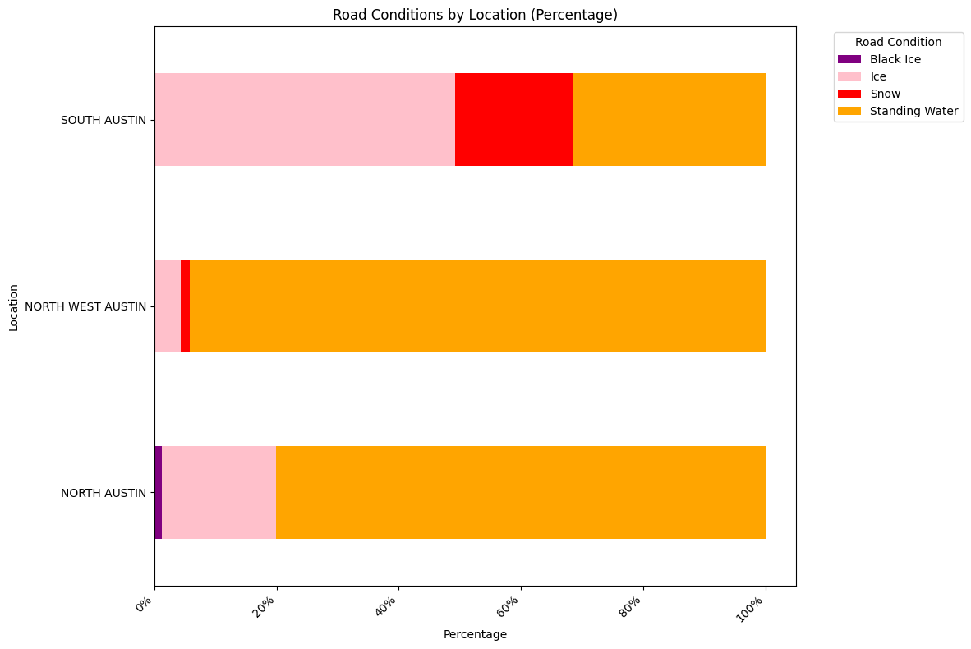
Bad Road Conditions by Location (Percentage)

Slide 30
Bad Road Conditions by Location (Percentage)
Both locations are by water

Slide 31
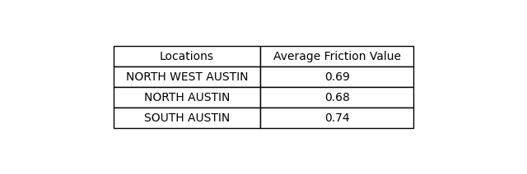
Average Friction Value During Winter Month

Slide 32
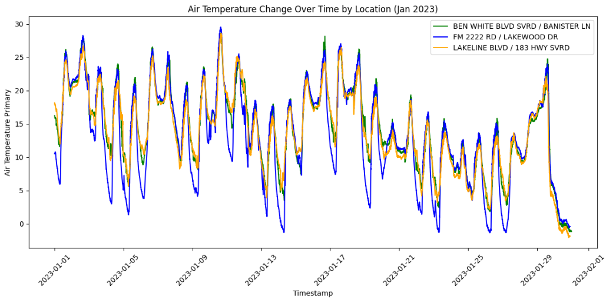
Air Temperature Change Over Time by Location
SOUTH AUSTIN
NORTH WEST AUSTIN
NORTH AUSTIN

Slide 33
Air Temperature Change Over Time by Location
SOUTH AUSTIN
NORTH WEST AUSTIN
NORTH AUSTIN

Slide 34
NORTH WEST AUSTIN intersection is a bridge
Notes:
Bridge conclusion: In conclusion, while this location doesn’t often freeze, its status as a bridge means it gets colder faster and stays frozen longer than surrounding roads. This makes it especially hazardous when freezing conditions do occur. Because of this, it’s crucial to monitor it more closely and take extra precautions, as it can become icy before other locations and remain dangerous for longer.

Slide 35

NORTH WEST AUSTIN intersection is a bridge
Notes:
Bridge conclusion: In conclusion, while this location doesn’t often freeze, its status as a bridge means it gets colder faster and stays frozen longer than surrounding roads. This makes it especially hazardous when freezing conditions do occur. Because of this, it’s crucial to monitor it more closely and take extra precautions, as it can become icy before other locations and remain dangerous for longer.

Slide 36
Conclusion
Notes:
due to the lakes and retention ponds that surround the area
salt the roads that are over water

Slide 37
Conclusion
South Austin shows better road conditions than other Austin areas.
Notes:
due to the lakes and retention ponds that surround the area
salt the roads that are over water

Slide 38
Conclusion
South Austin shows better road conditions than other Austin areas.
Geographically, conditions are strongly affected by the location of the road.
Notes:
due to the lakes and retention ponds that surround the area
salt the roads that are over water

Slide 39
Conclusion
South Austin shows better road conditions than other Austin areas.
Geographically, conditions are strongly affected by the location of the road.
Friction is a big indicator of road quality
Low friction = bad road conditions and high friction = good road conditions.
Notes:
due to the lakes and retention ponds that surround the area
salt the roads that are over water

Slide 40
Conclusion
South Austin shows better road conditions than other Austin areas.
Geographically, conditions are strongly affected by the location of the road.
Friction is a big indicator of road quality
Low friction = bad road conditions and high friction = good road conditions.
Why is this relevant?
Notes:
well to Austin road officials, there needs to be a more directed force on salting roads with low friction, (like bridges), and to Austin drivers, it is relevant to understand the circumstances of bad road conditions!!

Slide 41
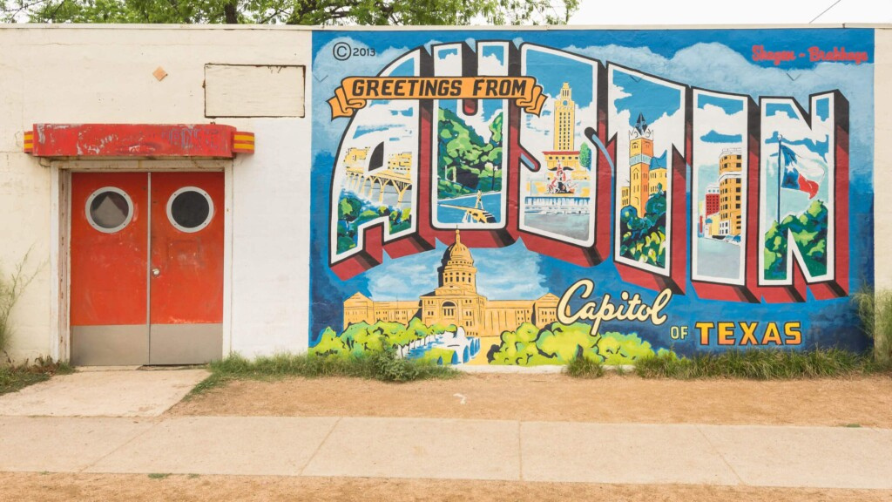
THE END
Any questions?

Slide 42
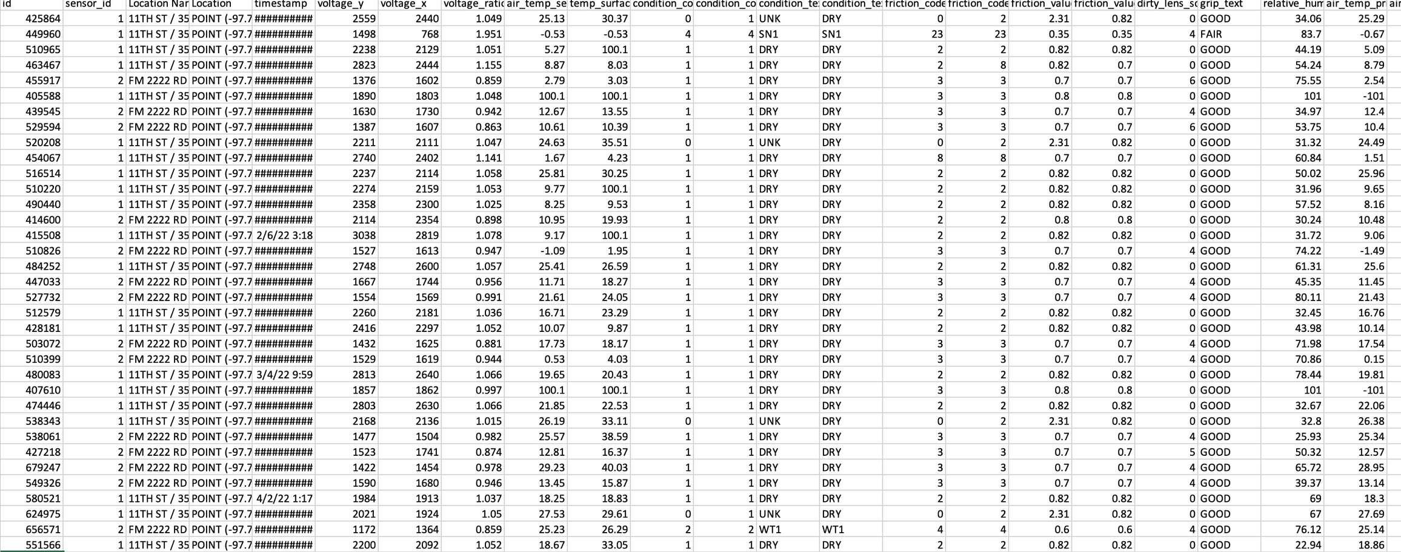
Raw Data

